Slide 1
Presentation on
Crop Yield Prediction using Decision Tree Regression from Scratch
Presented by,
Prashanth M

Slide 2
MACHINE LEARNING MODEL FROM SCRATCH
Problem Understanding
Data Collection.
Data Preparation.
Choose a Model.
Construct the Model Class from Python OOPs
Train the Model
Evaluate the Model
Parameter Tuning
Make Predictions

Slide 3
PROBLEM STATEMENT
Crop yield prediction is an important agricultural problem. The Agricultural yield primarily depends on weather conditions (rain, temperature, etc), pesticides and accurate information about history of crop yield is an important thing for making decisions related to agricultural risk management and future predictions.

Slide 4
BUILDING ALGORITHM FROM SCRATCH
Pandas and Numpy Libraries are used to handle dataframes and numerical arrays respectively.
All pre-processing steps , Train-test Split , Model building process is carried out by these libraries.
Python Class , methods and Functions.
While building algorithm from scratch one should have pre knowledge of model working and its parameters.
Matplotlib and seaborn are used for visualization.

Slide 5
DATASET
Datasets consists of four CSV files.
yield.csv : consists of target attribute values.
rain.csv : consists data of rainfall in mm at different areas in yearly manner.
pestisides.csv : total amount of pestisides used in tonnes in different areas.
temp.csv : data of temperature of different areas.
These files are of different shape and size. So we have to extract common data that are provided with target value.
So we have to merge CSV files based on common attributes between them.

Slide 6
Final dataset
Area and Year are the two features present in all files.So, merging is carried on using those features.
Rows : Dataset Consists of 28248 number of instances including all missing values.
Columns : Dataset Consists of 7 attributes including target variable.
5 Numerical
2 Categorical
Target variable : ” hg/ha_yield ”
Problem type : Regression

Slide 7
Data Cleaning and Pre-processing

Slide 8
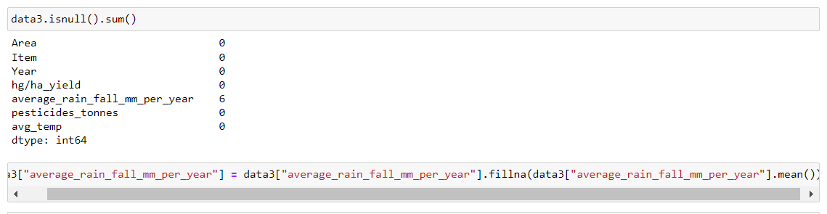
Checking and treating missing values
Missing values are imputed using mean of that column.

Slide 9
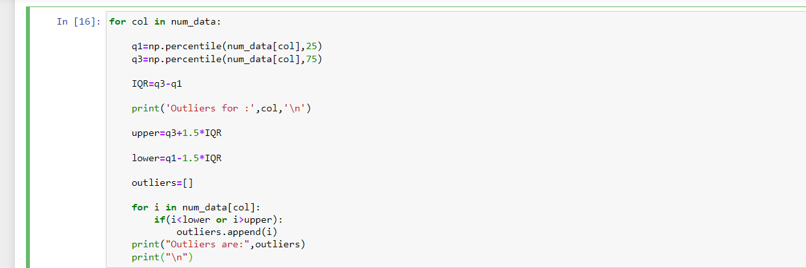
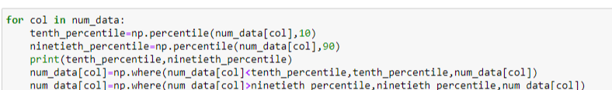
OUTLIER TREATMENT
I have used IQR for detecting Outliers and tenth & ninty percentile values to replace the outliers.

Slide 10
Encoding the Categorical Data
There were 2 categorical features in dataset
By using pd.get_dummies() for Encoding.

Slide 11
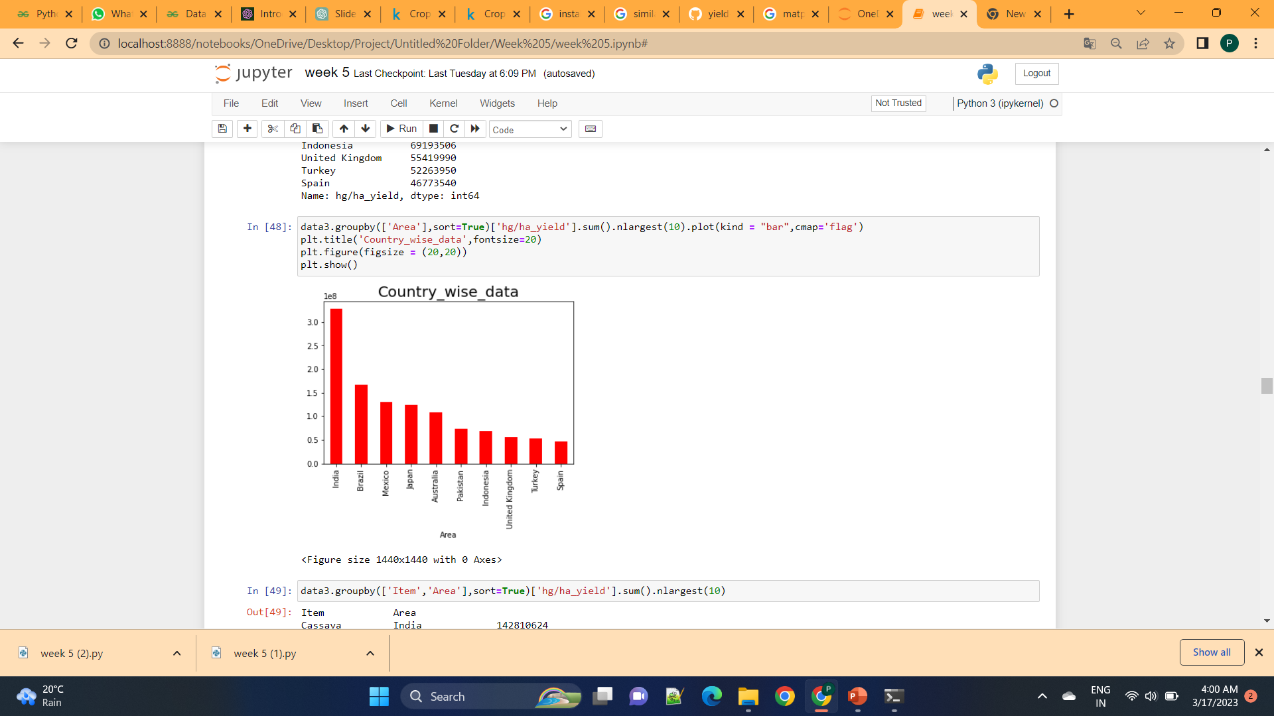
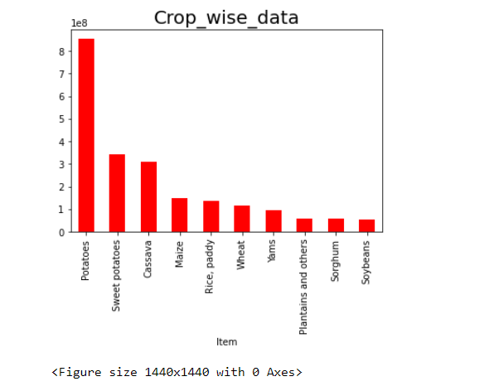
visualization
India is growing highest quantity of crops in the world and highly grown crop is Potato.

Slide 12
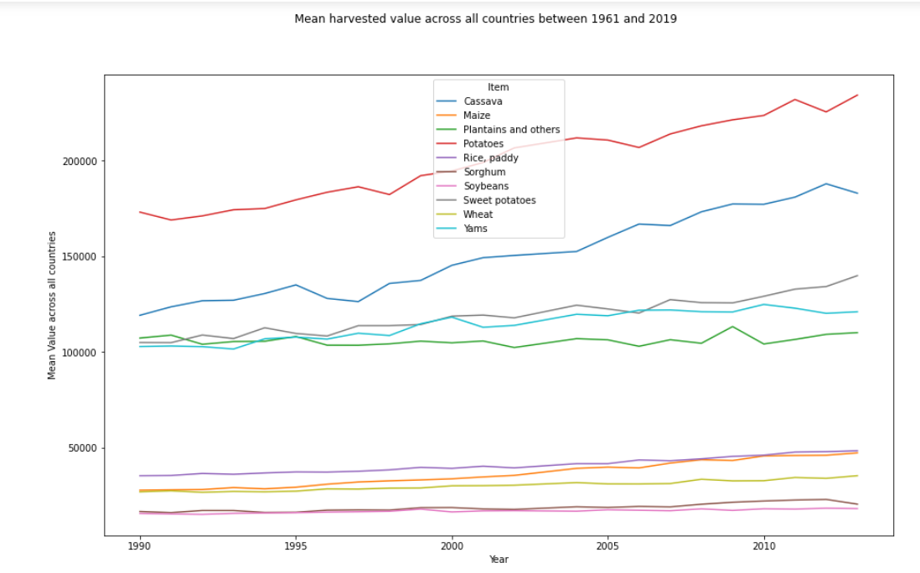
Above figure shows the drastic increase in the harvest from year to year.
Potatos are high in harvesting.

Slide 13
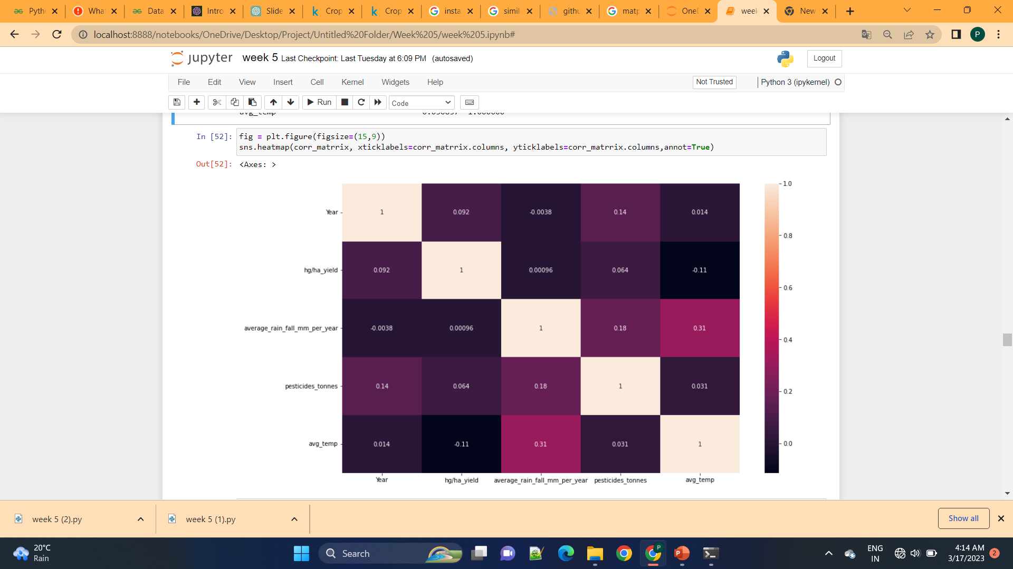
Correlation matrix
Features are not highly correlated with each aother and also less related to target function.

Slide 14
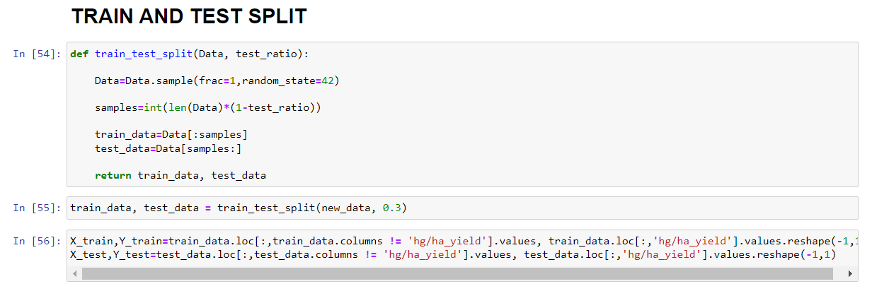
TRAIN TEST SPLIT
Sample function is used to randomize the data.
Test ratio is used to divide the data appropriately to fed into the model for training and testing.

Slide 15
Models Building

Slide 16
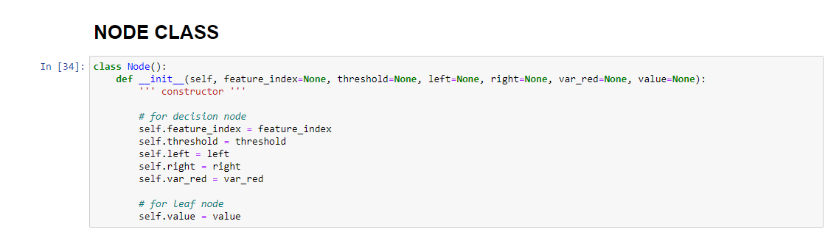
NODE CLASS
Node class is a constuctor that defines all the attributes present at the decision node.

Slide 17
TREE CLASS
It consist of constructer the defines tree parameters which are used as stopping criterion for a decision tree.
Various functions those defines each and every step of building perfect CART decision tree regressor.
Those are:
build_tree function : Defines procedure to build tree and returns leaf value.
get_best_split : Splitting procedure is explained here and returns best split.
split : Explains splitting the features.
variance_reduction : Define varience reduction formula to determine best split.
calculate_leaf_value : Calculates leaf node Value.
fit : fitting data into model.
make_prediction and predict : for output prediction.
mse and r_squared : Evaluation of model

Slide 18
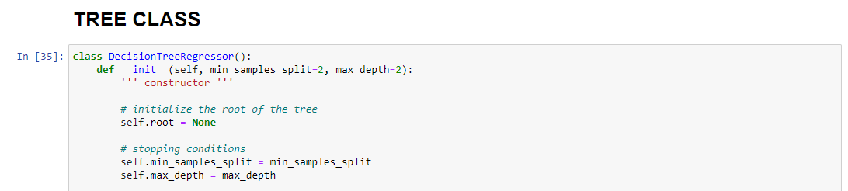
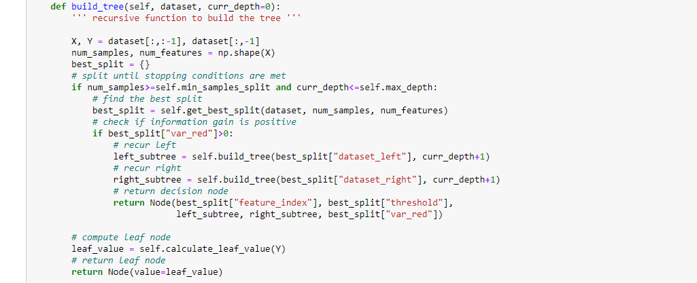

Slide 19
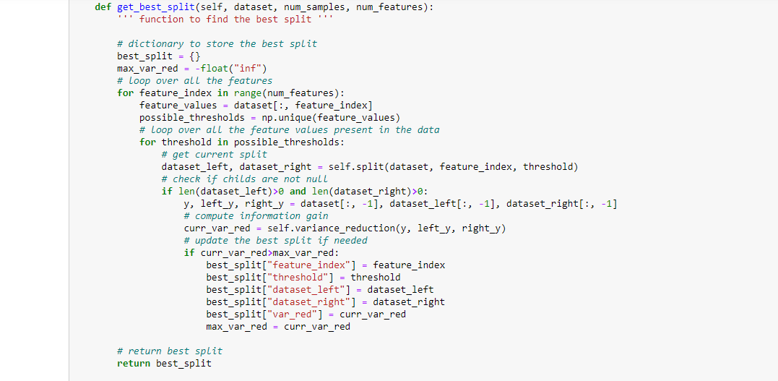
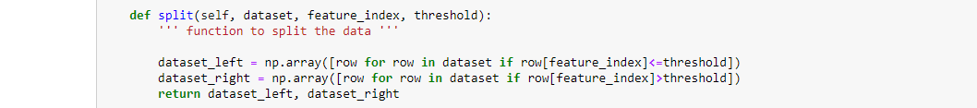

Slide 20
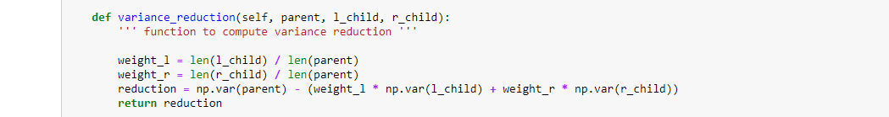
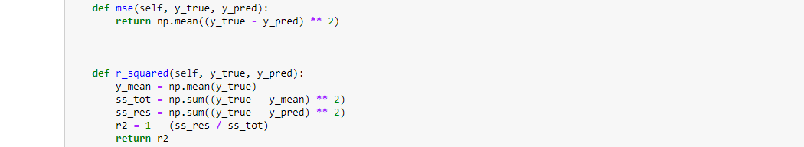

Slide 21
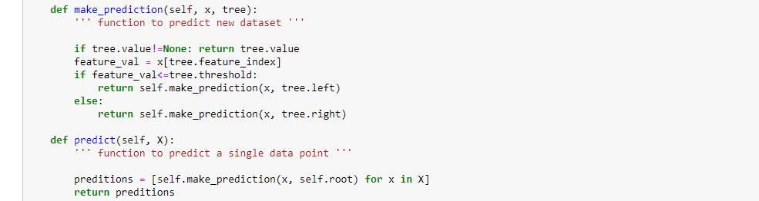

Slide 22
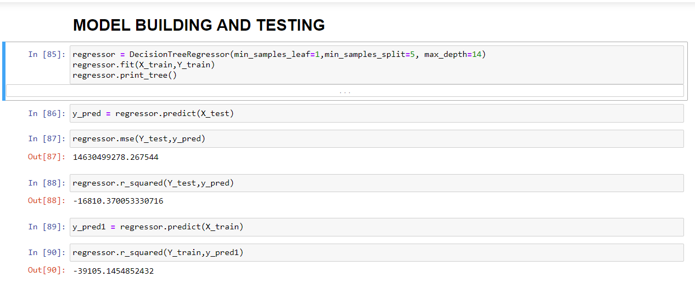
MODEL

Slide 23
Model Predictions
MSE of the model I got is 14630499278.26 which is quite high.
R2 value is for testing -16810.37 which is very bad for decision tree indicates data is not fitted properly to the model and it requires tuning.
So, the model requires hyperparameter tuning.

Slide 24
HYPER PARAMETER TUNING USING GRIDSEARCHCV
grid_search _cv is the function used here to do hyperparameter tuning.
This involves Cross validation and fit methods in the model.
Cross validation method splits the data and test the average score of the model providing different input data to the model.
Fit method fit the cross validated data for every iteration with parameter input.

Slide 25
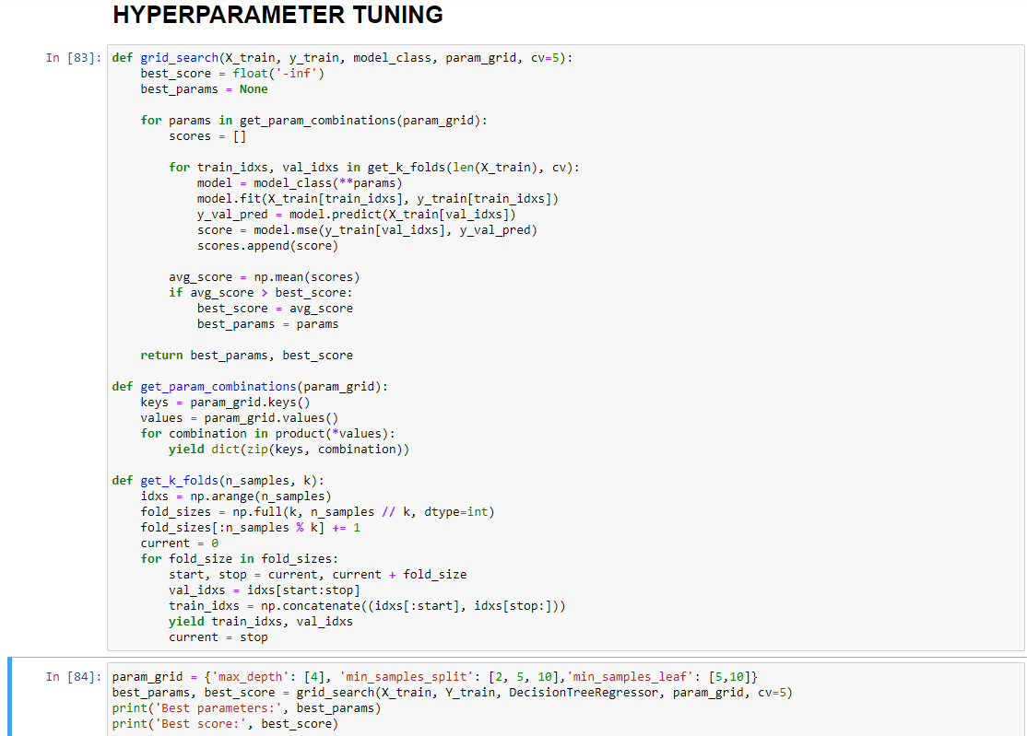

Slide 26
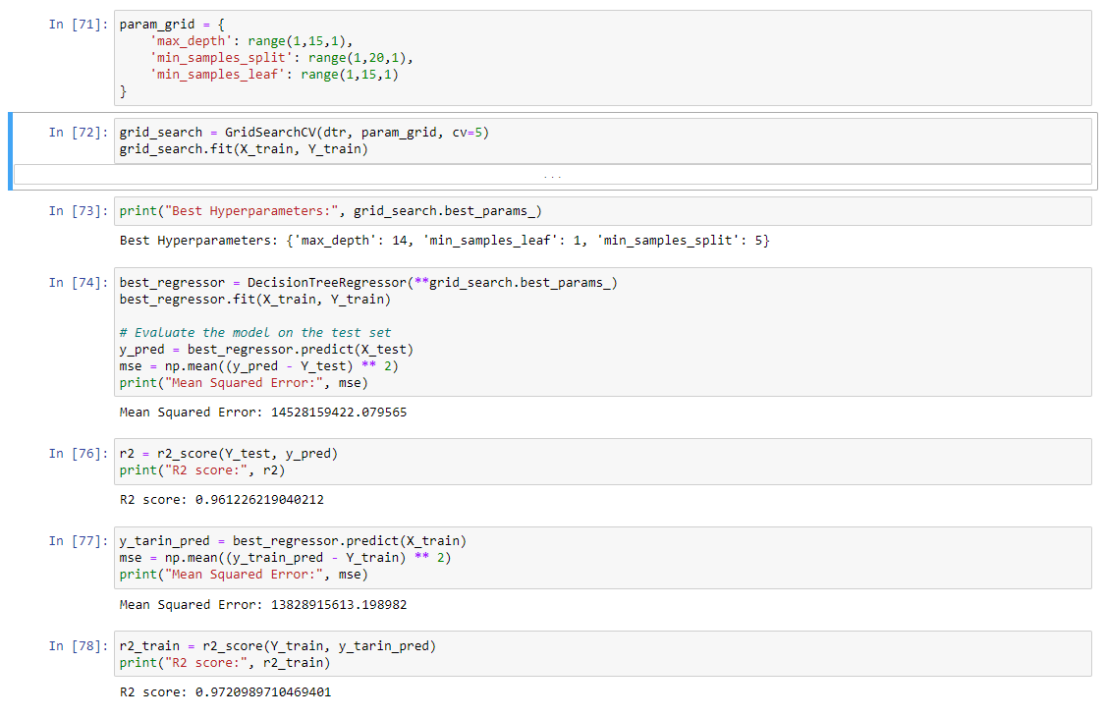
HYPERPARAMETER TUNING FROM SKLEARN

Slide 27
CONCLUSION
After HyperParameter Tuning,
mse value reduced with higher accuracy of the model.
R_squared score of the model is reached 96% for test data and 97% for train data.
model predictions are good after tuning the parameters.

Slide 28
Thank You

